Slide 1
Conceptual Database Design
Dr. S. RENUKA DEVI
Associate Profesor
SCSE
VIT Chennai Campus

Slide 2
Introduction to conceptual modelling
To design a database application
Database application refers to a particular database and the associated programs that implement the database queries and updates
Entity-Relationship (ER) model – widely used high-level conceptual data model
ER diagrams - the diagrammatic notation associated with the ER model

Slide 3
High level conceptual data models for database design
Database design process
1. Requirements collection and analysis
Database designers collect and record the data requirements from the database users
In addition, functional requirements are also specified
2. Create a conceptual schema
conceptual schema is a concise description of the data requirements of the users
It includes detailed description of the entity types, relationships and constraints

Slide 4
Database design process (contd…)
3. Actual implementation of the database
using a commercial DBMS.
commercial DBMSs use an implementation data model—such as the relational or the object-relational database model
conceptual schema is transformed from the high-level data model into the implementation data model - logical design or data model mapping
4. Physical Design
Internal storage structures, file organizations, indexes, access paths, and physical design parameters for the database files are specified

Slide 5
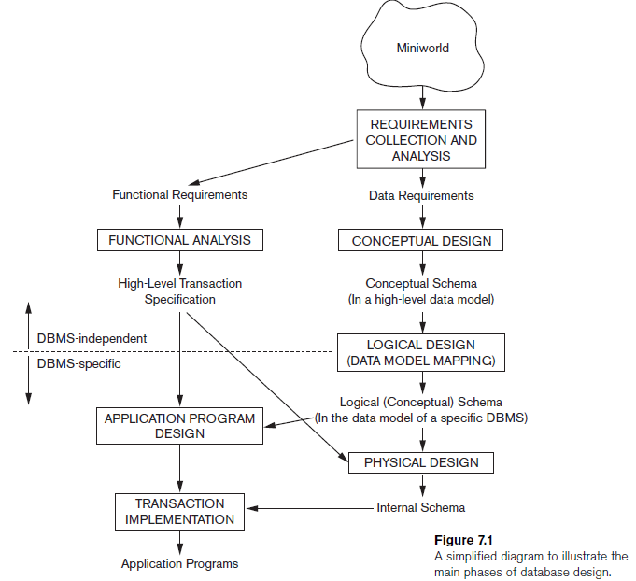

Slide 6
Entities and Attributes
Entity – object with physical or logical existence
Each entity has attributes - properties that describe it
E.g., student – entity
Name, regno, age, hobbies – attributes
Attributes are of several types
simple versus composite
Singlevalued versus multivalued
stored versus derived

Slide 7
Types of Attributes
Simple attributes
Has atomic or indivisible values
Eg., name – a string
phoneno – ten digit number
Composite Attribtes
Has several components in the value
Eg., address

Slide 8
Types of Attributes
Single valued attributes
Has only one value rather than a set of values
E.g, placeofbirth
Multi-valued attributes
Has a set of values rather than a single value
E.g., qualification, courses enrolled, email address

Slide 9
Types of Attributes
Stored attributes
has defined values
E.g, dateofbirth
Derived attributes
Attribute value is dependent on some other attribute
E.g., Age is derived from date of birth

Slide 10
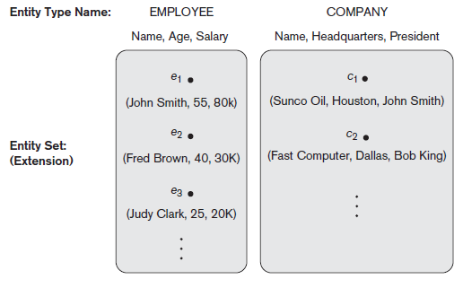
Entity type
Entity type - defines a collection (or set) of entities that have the same attributes
Each entity type in the database is described by its name and attributes
The collection of all entities of a particular entity type in the database at any point in time is called an entity set

Slide 11
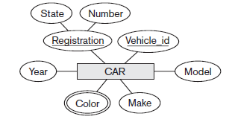
ER diagram representation
An entity type is represented in ER diagrams as a rectangular box enclosing the entity type name
Attribute names are enclosed in ovals and are attached to their entity type by straight lines
Composite attributes are attached to their component attributes by straight lines
Multivalued attributes are
displayed in double ovals.
Derived attributes - dashed ovals
Key attributes – underlined
An entity without a key –
Weak entity

Slide 12
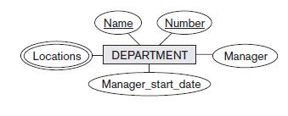
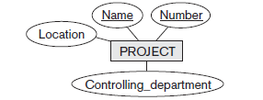

Slide 13
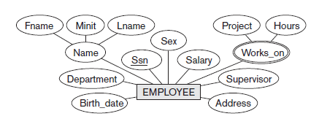


Slide 14
Relationship Types and Instances
A relationship type R among n entity types E1, E2, ..., En defines a set of associations
Each relationship instance r_{i} in R is an association of entities, where the association includes exactly one entity from each participating entity type
In ER diagrams, relationship types are displayed as diamond-shaped boxes
They are connected by straight lines to the rectangular boxes representing the participating entity types
The relationship name is displayed in the diamond-shaped box

Slide 15
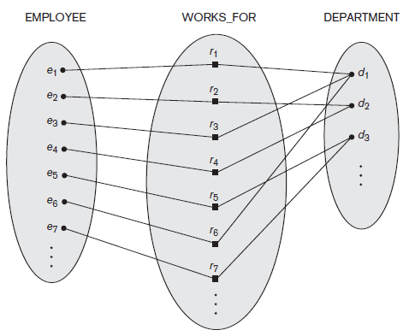
Relationship type WORKS_FOR between EMPLOYEE and DEPARTMENT

Slide 16
Relationship Degree
Degree of a relationship type is the number of participating entity types
E.g., the WORKS_FOR relationship is of degree two
A relationship type of degree two is called binary
A relationship type of degree three is called Ternary
Relationships can generally be of any degree, but the ones most common are binary relationships
Relationships can also be treated as attributes

Slide 17
Role names and Recursive Relationships
Each entity type that participates in a relationship type plays a particular role in the relationship
The role name signifies the role that a participating entity from the entity type plays in each relationship instance, and helps to explain what the relationship means
E.g., in the WORKS_FOR relationship type,
EMPLOYEE plays the role of employee or worker
DEPARTMENT plays the role of department or employer.
Recursive relationships - the same entity type participates more than once in a relationship type in different roles

Slide 18
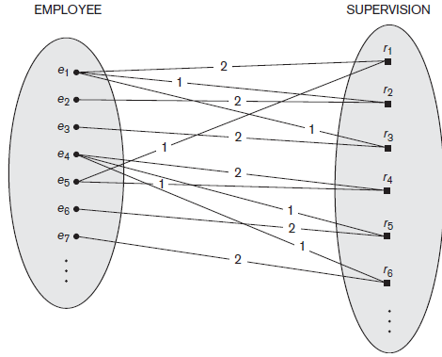
Recursive relationship
supervisor role - 1
subordinate role -2

Slide 19
Constraints on Binary Relationship Types
1. Cardinality Ratios for Binary Relationships
cardinality ratio for a binary relationship specifies the maximum number of relationship instances that an entity can participate in
E.g.,DEPARTMENT:EMPLOYEE is of cardinality ratio 1:N
Relationship type WORKS_ON is of cardinality ratio M:N
Possible cardinality ratios for binary relationship types are 1:1, 1:N, N:1, and M:N
Cardinality ratios for binary relationships are represented on ER diagrams by displaying 1, M, and N on the diamonds

Slide 20
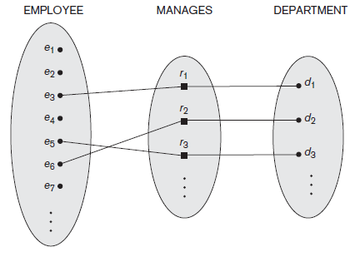
1:1 relationship

Slide 21
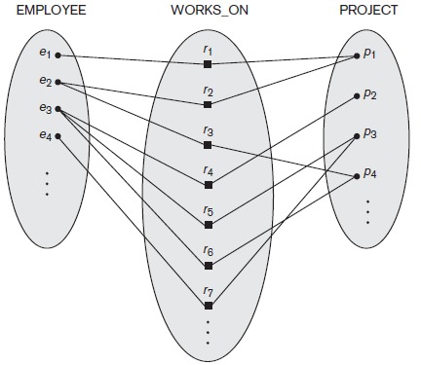
M:N Relationship

Slide 22
Constraints on Binary Relationship Types
2. Participation Constraints and Existence Dependencies
Participation constraint specifies the minimum number of relationship instances that each entity can participate in
Sometimes called the minimum cardinality constraint
Two types of participation
Total participation ( also called existence dependency)
E.g., - the participation of EMPLOYEE in WORKS_FOR relationship
Partial Participation
Eg., the participation of EMPLOYEE in the MANAGES relationship

Slide 23
Constraints on Binary Relationship Types
structural constraints of a relationship type – Combination of cardinality ratio and participation constraints
In ER diagrams, total participation is displayed as a double line connecting the participating entity type to the relationship
partial participation is represented by a single line

Slide 24
Weak Entity Type
Weak entity types - Entity types that do not have key attributes of their own
Identifying or owner entity type - Weak Entities are identified by being related to specific entities from another entity type
Identifying relationship - relationship type that relates a weak entity type to its owner
weak entity type always has a total participation constraint with respect to its identifying relationship
A weak entity type normally has a partial key
In the worst case, a composite attribute of all the weak entity’s attributes will be the partial key.

Slide 25
Weak Entity Type
In ER diagrams, both a weak entity type and its identifying relationship are distinguished by surrounding their boxes and diamonds with double lines
The partial key attribute is underlined with a dashed or dotted line.
In general, any number of levels of weak entity types can be defined
an owner entity type may itself be a weak entity type
a weak entity type may have more than one identifying entity type and an identifying relationship type

Slide 26
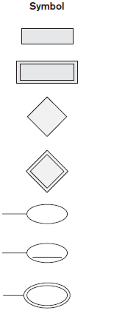
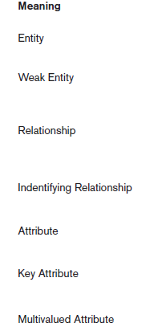
Notations of ER Diagram

Slide 27
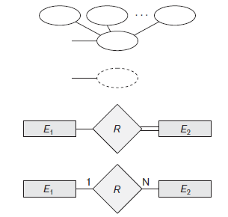
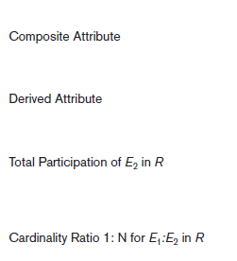
Notations of ER Diagram

Slide 28
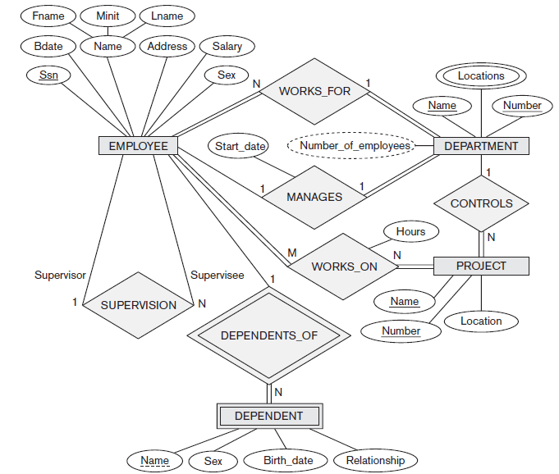
ER diagram for Company DB

Slide 29
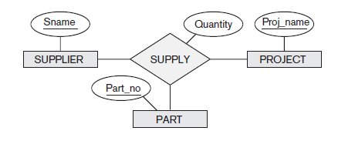
Relationship types of degree higher than two

Slide 30
Any queries?

